Slide 1
www.hcdf.org

Slide 2
A THEOLOGY OF SERVICE
How to best serve God, His Kingdom and our communities

Slide 3
Classical Community Organizing
VS
Holistic Christian Community Development
The Definition of Community Organizing
Classic: The coordination of cooperative efforts and campaigning carried out by local residents to promote the interests of their community.
Wikipedia: Community organizing is a process where people who live in proximity to each other come together into an organization that acts in their shared self-interest.

Slide 4
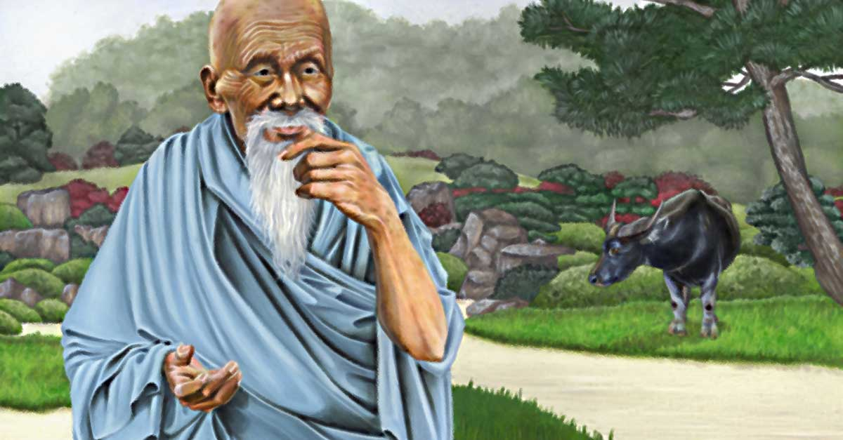
A Brief Visual History of Community Organizing
Lao Tzu (400 BC?)

Slide 5
A Brief Visual History of Community Organizing
Jesus Christ

Slide 6
A Brief Visual History of Community Organizing
Susan B. Anthony (1820-1906 [Women Suffrage])

Slide 7
A Brief Visual History of Community Organizing
Harriett Tubman (1822-1913 [Underground Railroad])

Slide 8
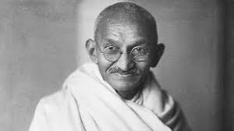
A Brief Visual History of Community Organizing
Mohandas Gandhi (1869-1948 [Passive Resistance])

Slide 9
A Brief Visual History of Community Organizing
Saul Alinski (1909-1972 [Father of Modern Community Organizing])

Slide 10
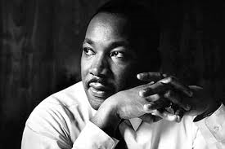
A Brief Visual History of Community Organizing
(1929-1968 [Civil Rights Leader])
Martin Luther King, jr

Slide 11
Types of Community Organizing
Social Work: Delivering social services to the community
Political Activist:
Empowering the neglected
Neighborhood Maintenance/Community Development:
Improving economic potential

Slide 12
Si Kahn’s Principles of Community Organizing
Common Self-Interest (as participant or inactive opponent)
Advocate a positive and oppose a negative
Aim for simplicity
Resist casting people into stereotypes
Demonstrations is the best vehicle
Publicize the cost to all participants
‘Laughter is therapeutic’
Don’t be a know it all
Power corrupts even if you were a victim before assuming power
Whom you know counts
A community leader and a community organizer is not the same
Never compromise with injustice

Slide 13
Obama as Community Organizer in Chief
“I can bring this country together. I have a track record, starting from the days I moved to Chicago as a community organizer.” Barack Obama

Slide 14
Obama as Community Organizer in Chief
“I guess a small-town mayor is sort of like a community organizer except that you have actual responsibilities.” Sarah Palin

Slide 15
Classical Community Organizing
Holistic Christian Community Organizing
The Definition of Holistic Christian Community Development
The dedication of men and women of a local community who are driven with a passion for ‘jubilee’ justice to commit themselves to mobilizing the human resources of that community to improve the lives of the residents of that community spiritually, socially and economically through the Church (JLT).

Slide 16
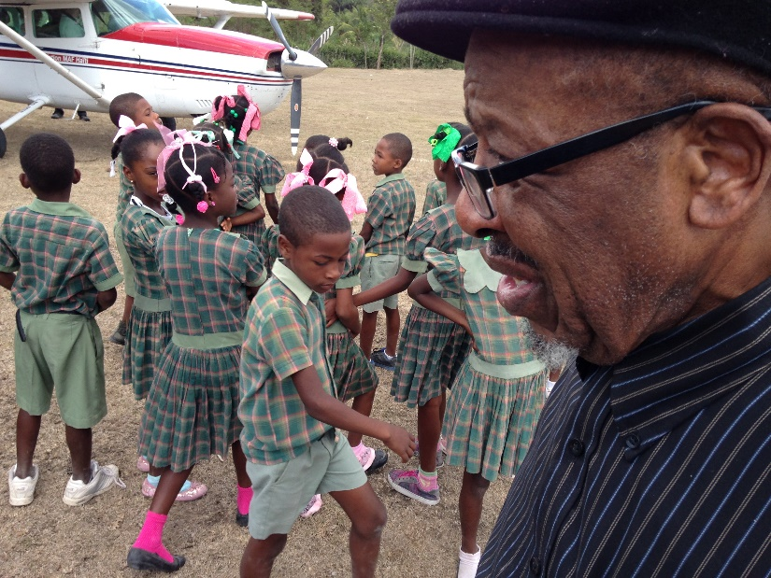
Holistic Christian Community Organizing
John Perkins Principles of Holistic Christian Community Development
Principles of holistic Christian Community Organizing:
The Three R’s
Reconciliation --Human dignity
Relocation --Felt need (community organizing)
Redistribution --Empowering the oppressed

Slide 17
Holistic Christian Community Organizing
Reconciliation
Relocation
Redistribution

Slide 18
Holistic Christian Community Organizing
A call to Service

Slide 19
Holistic Christian Community Organizing
The Three R’s of Holistic
Christian Community Organizing

Slide 20
Reconciliation
The Three R’s of Holistic
Christian Community Organizing
Reconciliation ... the indispensable message for an authentic Christian ministry
A servant has no personal ideology of his own. He is the ambassador of his Master.

Slide 21
Relocation
The Three R’s of Holistic
Christian Community Organizing
Relocation ... the best method to achieve an authentic Christian ministry
A servant has no country of his own (earthly citizenship). He goes wherever his Master sends him.

Slide 22
Redistribution
The Three R’s of Holistic
Christian Community Organizing
Redistribution ... The tangible demonstration of an authentic Christian ministry
A servant has no possessions of his own. He is the manager of the property of his Master.

Slide 23
Holistic Christian Community Organizing
Reconciliation
Relocation
Redistribution

Slide 24
www.hcdf.org

