Slide 1
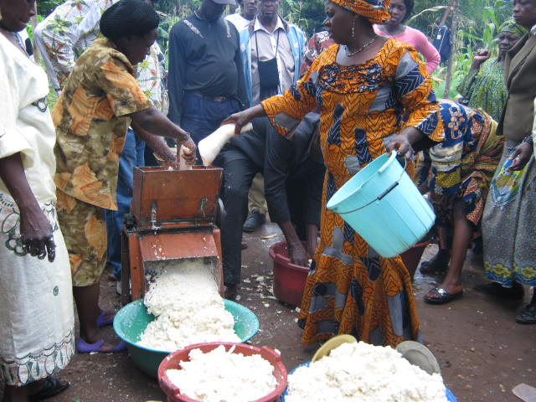
STARTING AND SUSTAINING A NGO- THE CASE OF SIRDEP
PRESENTED BY
Mme MBAH GRACE NYIEH
BOARD CHAIRPERSON

Slide 2
OUTLINE
Introduction
Genesis
Initial Management
Growth and Management Strategies
Networking/partnership development
Successes and Challenges
Conclusion

Slide 3
Introduction
Society for Initiatives in Rural Development and Environmental Protection (SIRDEP)
Location: Ntarinkon Mankon - Bamenda
Address: P.O. Box 682 Mankon-Bamenda
North West Region - Cameroon
E-mail: sirdepconsult@yahoo.com
Tel: (237) 33208961 / 77501456 / 77501451
Website: www.sirdep.wordpress.com

Slide 4
Genesis
Originated from a common vision of 4 founding members (2 females 2 males) in 1992 , Colleagues in German Project and also people who had studied abroad and decided to come back home
Zero Funding
Problem How to reach communities or rural poor with participatory development initiatives out of Gov’t Structures
Legalisation process
No NGO legal frame work, hence Law of association Recognized officially in 1993

Slide 5
Genesis Cont
Setting up of the structure
Executive /Board of Directors, Logistics, office, staff etc ( a bamboo chair and a little table)
Initial management
Co opted other multidisplinary/ talented friends and colleagues into the fold
Volunteer co –ordinator and one paid staff (from member contributions)

Slide 6
Growth and Management Strategies
Accountability/Transparency
Financial and narrative reporting(half yearly)
External and internal audits (yearly )
Manuals of procedures
Rigorous Checks/balance (Board meetings and executive co-ordination meetings)
Strategic planning, implementation, Monitoring and evaluation
3 year strategic plan (Elaborated by Board and Executive)
Ensures the steering of the organization in the direction of growth

Slide 7
Growth and Management Strategies cont
Yearly operational plan ( Derived from the Strategic Plan and budget is based on it. (Done by executive and presented to board for approval > 50MFCFA)
Monitoring and Evaluation is carried out at all levels to ensure smooth implementation

Slide 8
Mobilisation of resources (fund raising)
Provision of services (consultancy) >80% of our income
Projects proposals
Subventions from Government
Contributions from Membership dues about $60/annum/member

Slide 9
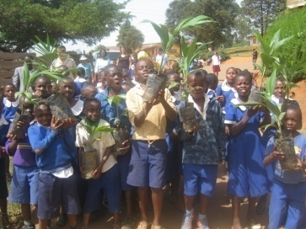
Investments
Landed property for office premises/rents for income
treasury ‘bons’
Term deposits

Slide 10
Internship /volunteer programme
Opportunities given to young graduates for field experience
Volunteers provide very useful services and sometimes source for funding
Nursery for SIRDEP and other NGOs for recruitment
Enhances partnership with some Gov’t services like the NEF and international organisations like VSO

Slide 11
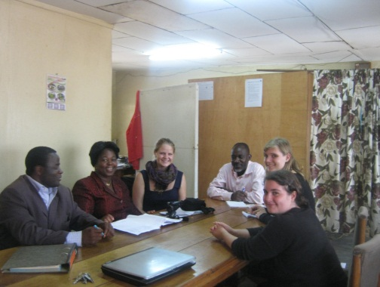
Networking/partnership development
Networking and partnership development has proven to be very rewarding in terms of:
Sharing information
Capacity building
Joint ventures
Fund raising opportunities
SIRDEP Belongs to 5 networks and has been in leadership position for some of them.

Slide 12
Successes
Built a high reputation (Branding) as a national NGO
Common vision of the members has not dwindled over the years
A strong multidisciplinary and professionally apt team in place
Scope of our clients has grown in leaps and bounds
Staff strength has grown 13 permanent staff 1 volunteer

Slide 13
Diversification
Creation of GBNP is a multiplier effect of SIRDEP
Young Cameroonians being given the quality education that is necessary for our development

Slide 14
Challenges
SIRDEP serves as a grooming ground for big international NGOs who recruit our well trained staff
Telling the story of our successes (No communication officer)
Being able to have funding from project proposals is very difficult
How to get a champion for our course

Slide 15
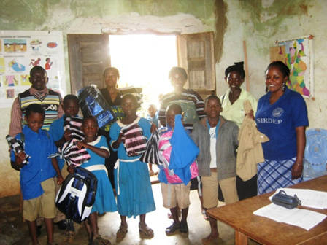
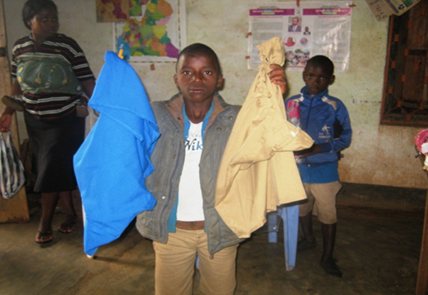
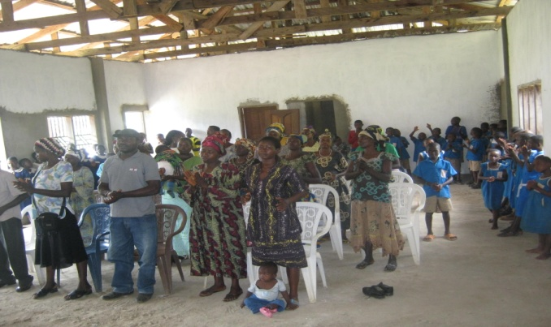
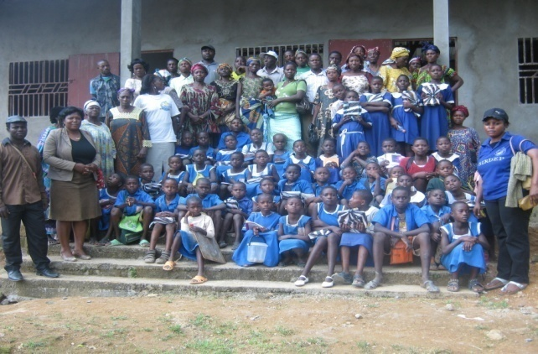
Orphans Programme
Victims or HIV/AIDS

Slide 16
Conclusion
Glory be to God for sustaining SIRDEP for the past 22 years

Slide 17
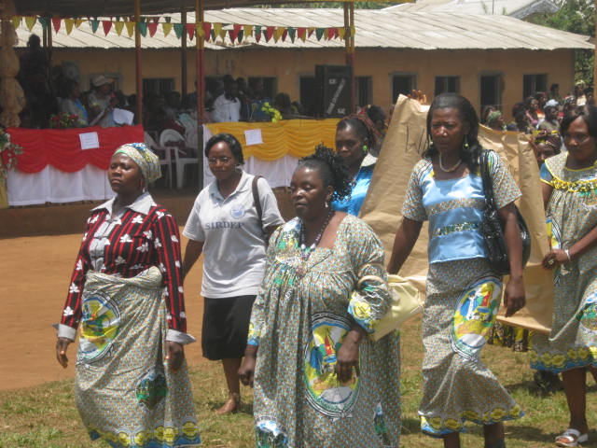
THANKS FOR YOUR KIND ATTENTION

