Slide 1
Hope for the Widows & Orphans Ministries (HWOM) P. O. Box 276 Bamenda Email: hopeforwidows@yahoo.com Website: www.hwomcam.org Tel: (237) 776-222-01

Slide 2
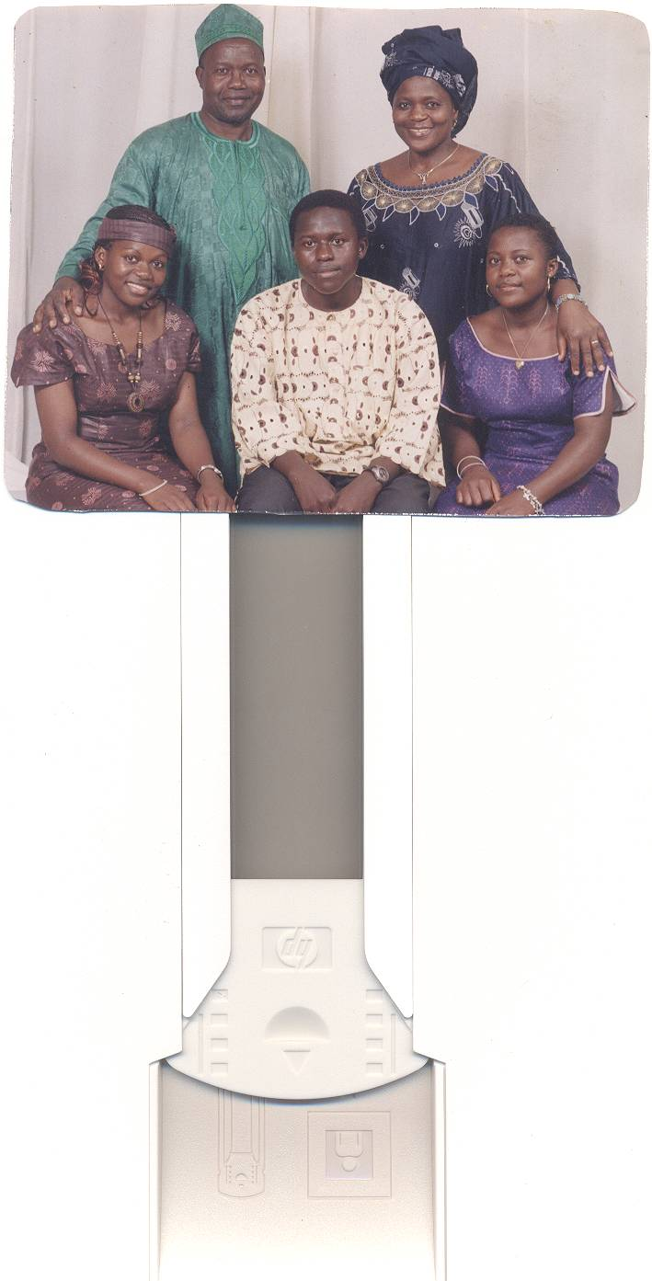
Founder/Family
Mirabelle, Sam, Chantal, Kevin & Nina KARAWA

Slide 3
Grandmother of three
KAYLA & JOEL
IAN

Slide 4
General Information
Status: A community based, interdenominational, Christian Organization with goals and objectives aimed at improving the livelihood of grass root widows & orphans spiritually and physically.
Date of creation: 07th April, 2000
Date of Registration: 07th May, 2003

Slide 5
General Information
Authorization Number: No. 0015/E29/1111/Vol.8/APPB
Geographical Coverage: National but operates more in the North West Region and part of Littoral and Yaounde.
Headquarter Office: Cow Street Nkwen Bamenda

Slide 6
General Information
Vision: A world in which widows and orphans are uplifted spiritually and empowered through love in action, hope and healing for self sustenance

Slide 7
General Information
Purpose Statement: HWOM is a community, faith-based Organization called by God to serve the widows and orphans in Cameroon
We purpose to empower widows and orphans to regain stability and live self-sustaining, delightful lives, through education, training and provision of spiritual, physical, economic, and socio-cultural relief.

Slide 8
General Information
Goal: HWOM seeks to alleviate poverty from among widows and orphans through spiritual encouragement and improvement of their socio-economic conditions.
Target Group: Widows and orphans

Slide 9
CHALLENGES OF WIDOWHOOD
Widowhood is greatly dreaded as a result of the violence inflicted on the Widow mainly in three major forms:
Mourning Practices
(which are detrimental to a woman’s health and dignity)
Denial of Inheritance Rights
(where property is seized and the widow chased out of her matrimonial home
General Degradation
(as a result of her status without her husband)

Slide 10
Widows suffer from all forms of violence:
Some widows are battered, raped
Widows are rejected, ignored, isolated and called names such as witch, prostitute, killer of her husband
Widows being pushed into prostitution just to make ends meet
Physical Violence
Psychological Violence
Economic Violence

Slide 11
DOMAINS OF ACTIVITIES
Counseling & Spiritual Support
Orphans Sponsorship program
Income Generating Activities
Charity Program
Medical Support
Communications & Public Relations

Slide 12
COUNSELING & SPIRITUAL SUPPORT
One on One Old & Young

Slide 13
SPIRITUAL COUNSELING & SUPPORT (Evangelism & Prayers)

Slide 14
SPIRITUAL COUNSELING & SUPPORT Comforting widows

Slide 15
Preparing Orphans to Face Life

Slide 16
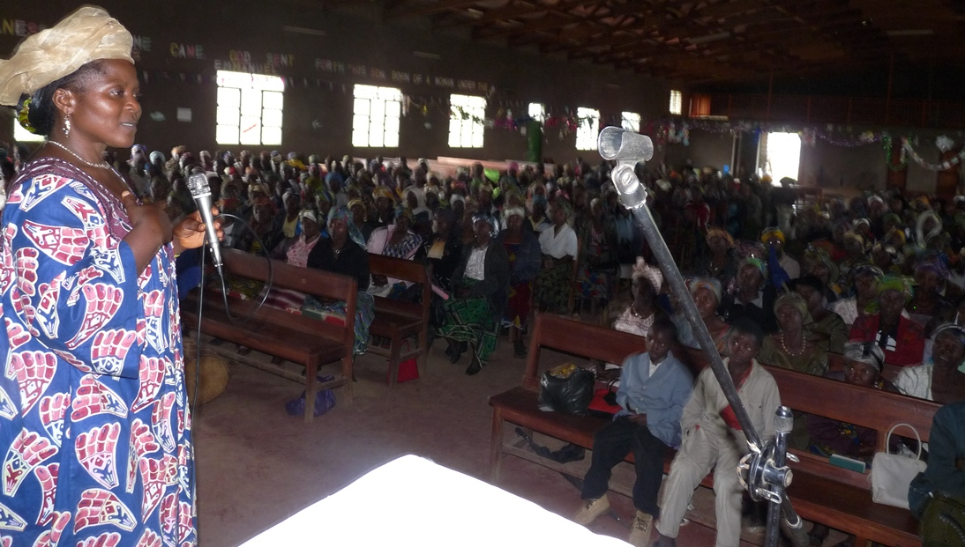
Conference of Hope 2010

Slide 17
ORPHANS SPONSORSHIP
Formal Education | Professional Training
Primary School | Carpentry
Secondary School | Hairdressing
High School | Tailoring
 | Motor mechanics
 | Metal Works

Slide 18
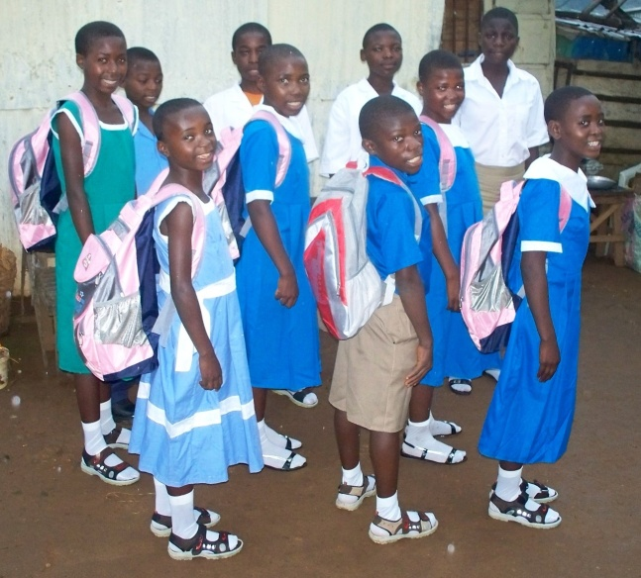
Formal Education
Pay Tuition
School Supplies:
Uniforms
School Bags
School Shoes/Socks
Writing Materials:
Textbooks
Exercise Books
Pens, Pencils, Rulers, etc

Slide 19
Giving Them a Sense of Belonging

Slide 20
Extremely needy orphans are provided with blankets, bush lamps and kerosene to enhance studies.

Slide 21
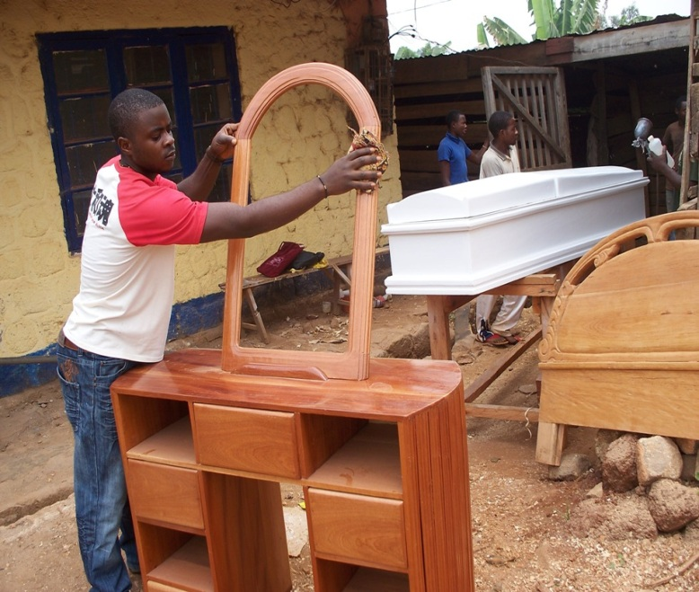
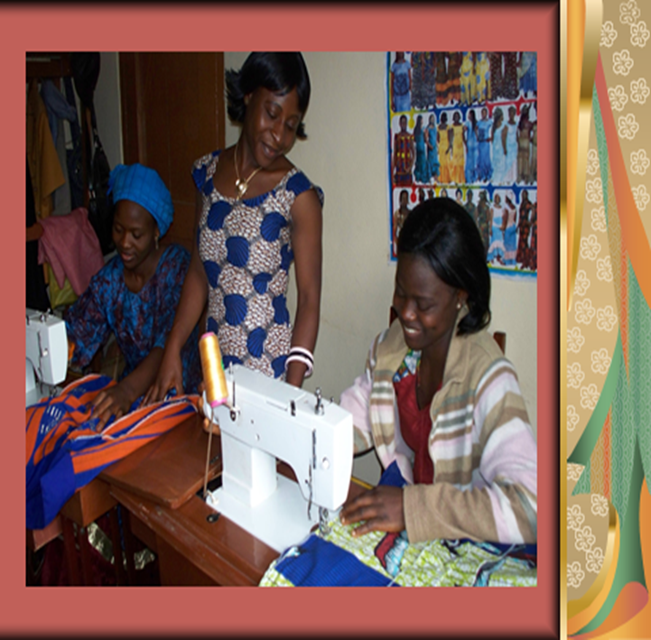
Professional Training
Pay tuition or apprenticeship fees
Buy work tools (if applicable)
Provide starting capital upon completion
Supervise until they are well established and on their own

Slide 22
Motor Mechanics
Edward Graduates with a diploma

Slide 23
INCOME GENERATING ACTIVITIES
Economic Empowerment for self-sustenance

Slide 24
INCOME GENERATING ACTIVITIES Promoting Self-Sustenance
Petty Trading
Small Livestock Production
Food Crop Production
Market Gardening
Tailoring & Knitting
Homemade Products

Slide 25
Food Crop Production
Hoes to ease crop cultivation for the widows
Improved Seed to increase/improve production

Slide 26
Food Crop Production
Fertilizer for the widows to boast/increase crop production
Market gardening

Slide 27
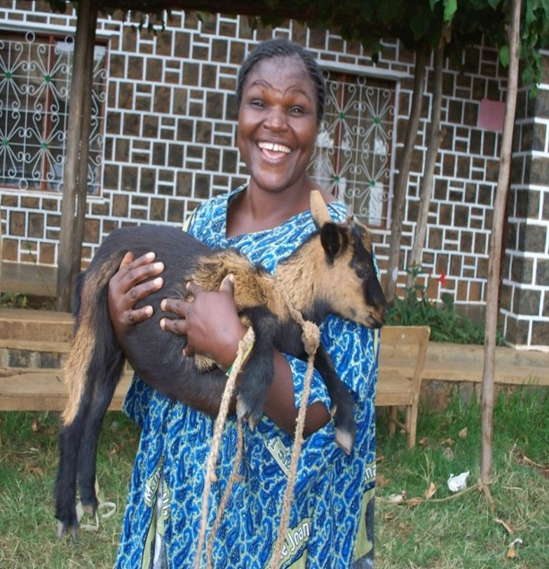
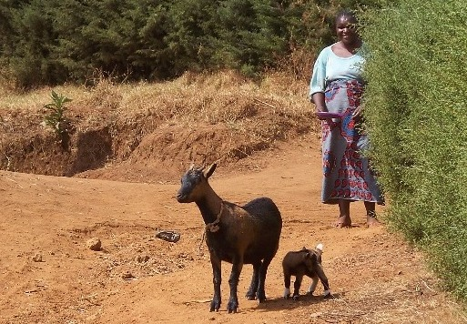
Livestock Production
Piglets
Goats (kids)

Slide 28
Small Livestock Production
Piggery Project for self-reliance
Passing On the Seed

Slide 29
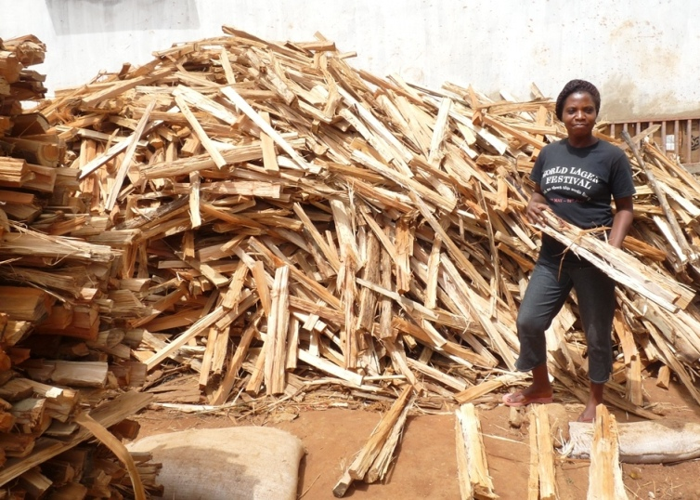
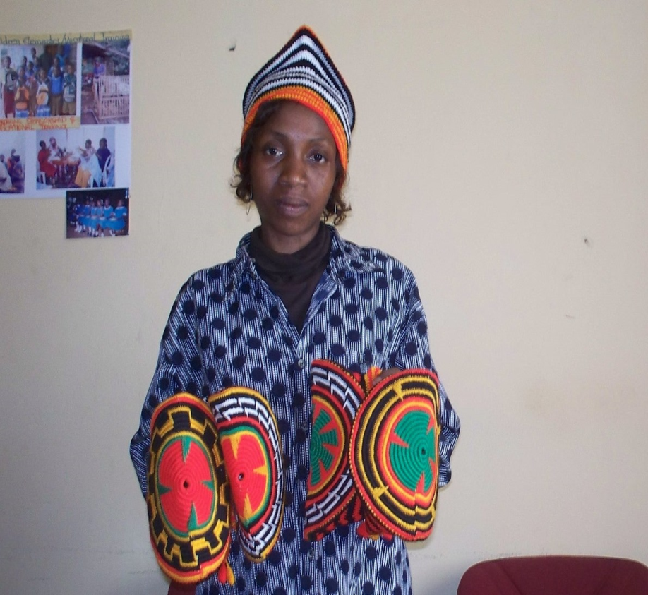
Petty Trading
Selling of firewood
Crocheting of traditional caps

Slide 30
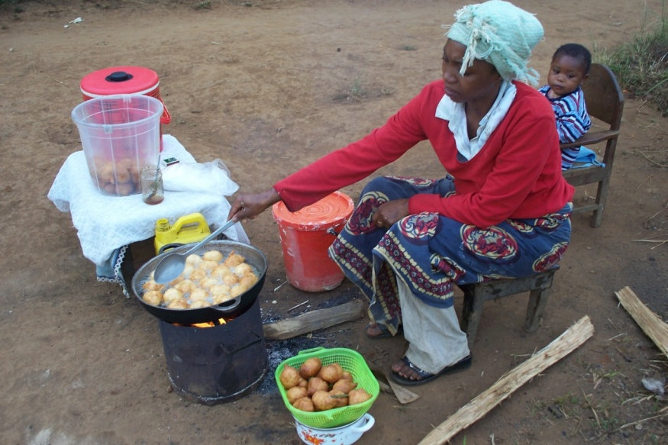
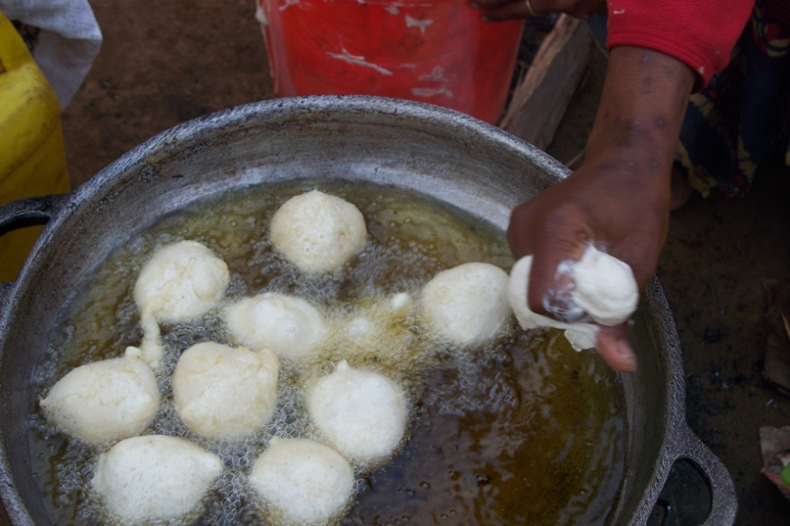
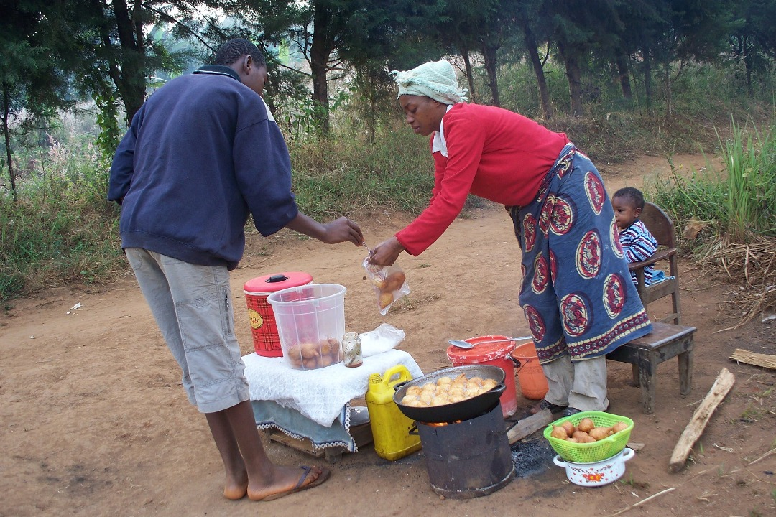

Slide 31
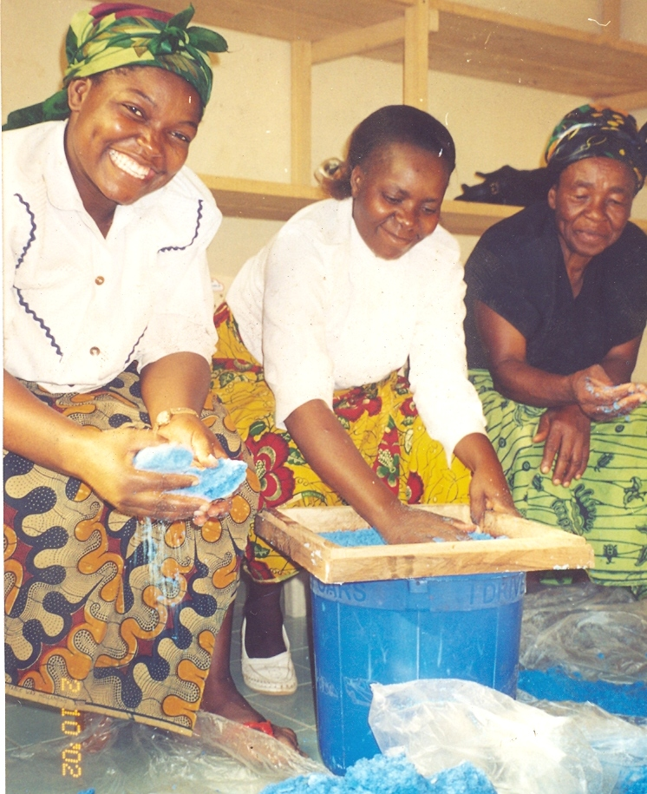
Homemade Products
Packaging for Marketing
Producing Powdered Soap

Slide 32
Body Lotions, Soap and Shampoo
Knitting of Ladies’ Hair Nets

Slide 33
CHARITY PROGRAM
Meeting Immediate Survival Needs:
- Food - Clothing - Shelter

Slide 34
Meeting Needs… Transforming Lives
Before
After

Slide 35
Before
After

Slide 36
After
Before

Slide 37
Empowerment for Self-sustenance

Slide 38
Construction of Small Houses for the Homeless
Before
After
Meeting Needs… Transforming Lives

Slide 39
Repairs of Dilapidated Houses
After
Before

Slide 40
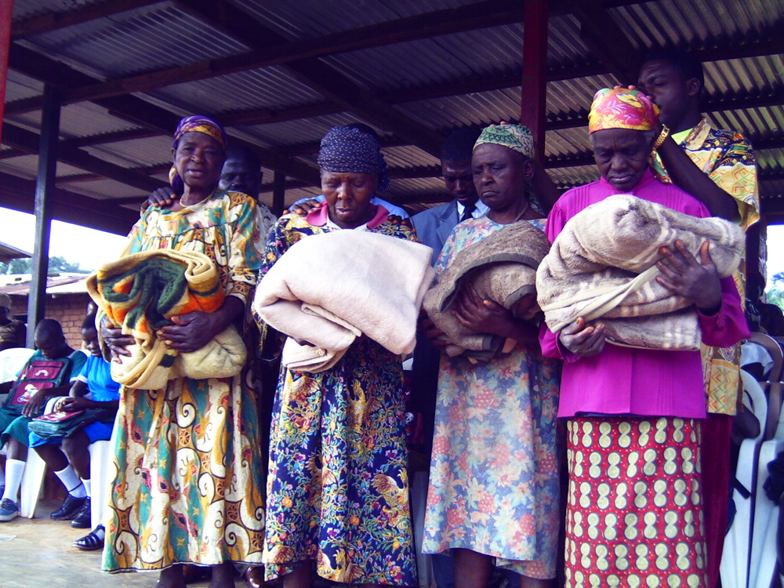
Blankets for the Elderly needy Widows

Slide 41
MEDICAL SUPPORT
Pay medical bills, Sensitize, Educate & Teach on:
HIV & AIDS
Cervical Cancer Screening
High Blood Pressure
Diabetes
Dental Care
Wounds, Etc.

Slide 42
HIV/AIDS
HWOM is making HIV/AIDS a priority issue.
Counseling & Testing

Slide 43
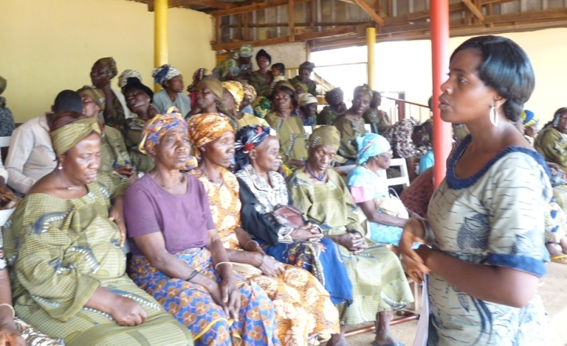
HIV Education & Support Groups

Slide 44
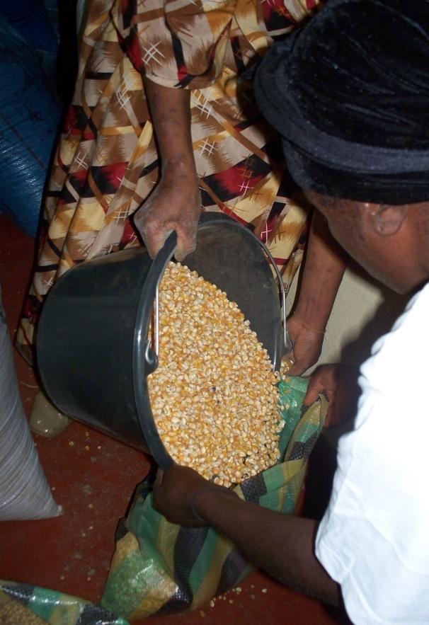
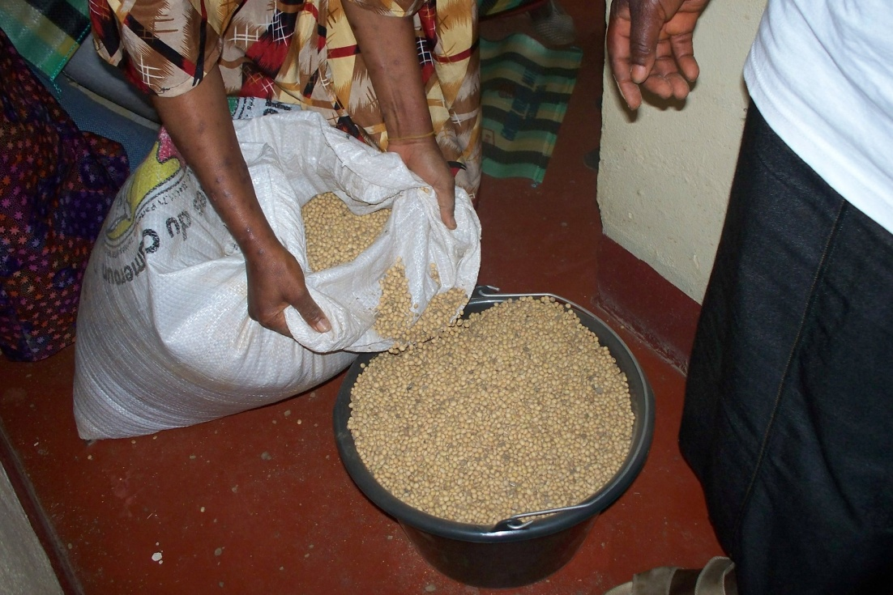
Distributing corn and soya beans to widows living with AIDS

Slide 45
Other Health Issues
Dental Care for widows & orphans
Testing for High Blood Pressure & Blood Sugar

Slide 46
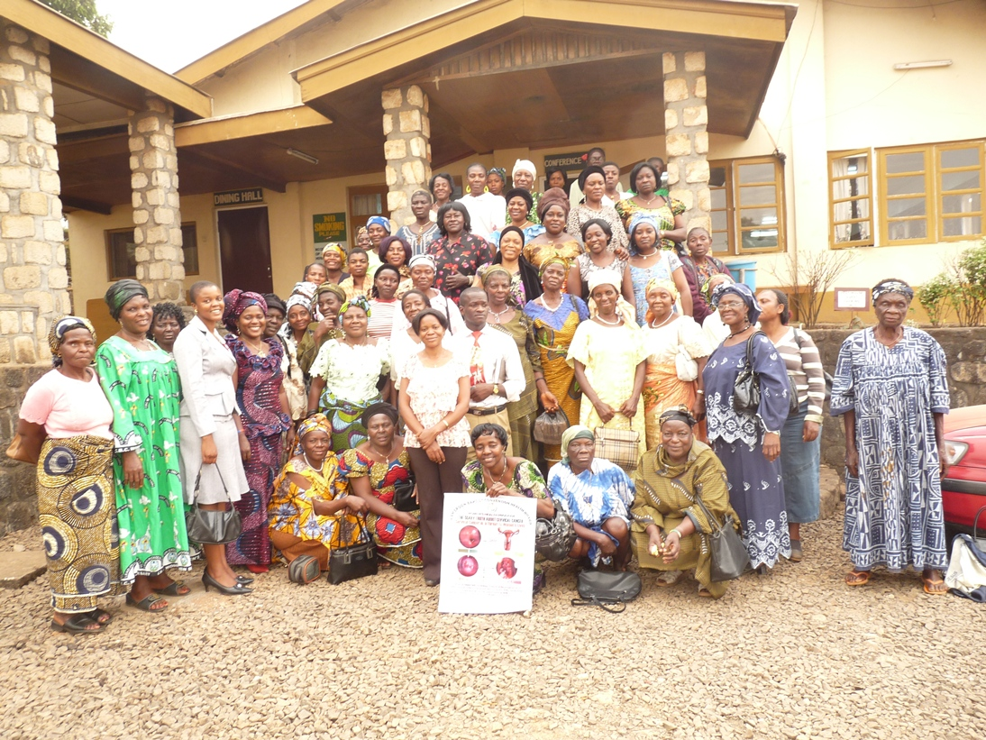
Other Health Issues
Cervical Cancer Education
Cervical Cancer Screening

Slide 47
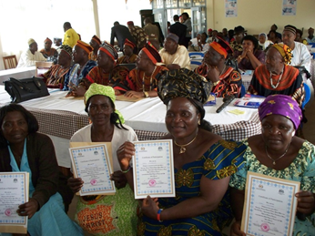
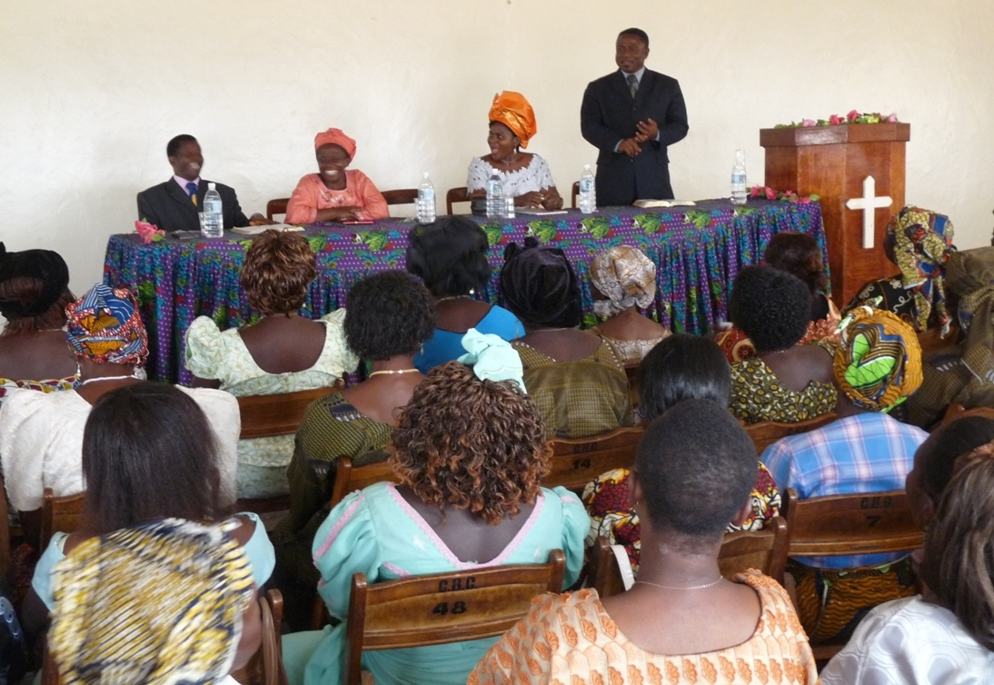
COMMUNICATION AND PUBLIC RELATIONS
Educative meetings with traditional rulers
Informative meetings with partners

Slide 48
COMMUNICATION AND PUBLIC RELATIONS
Educative talks in Churches
and Communities

Slide 49
THE END

Slide 50
THANK YOU!
THANK YOU!
THANK YOU!

